Slide 1
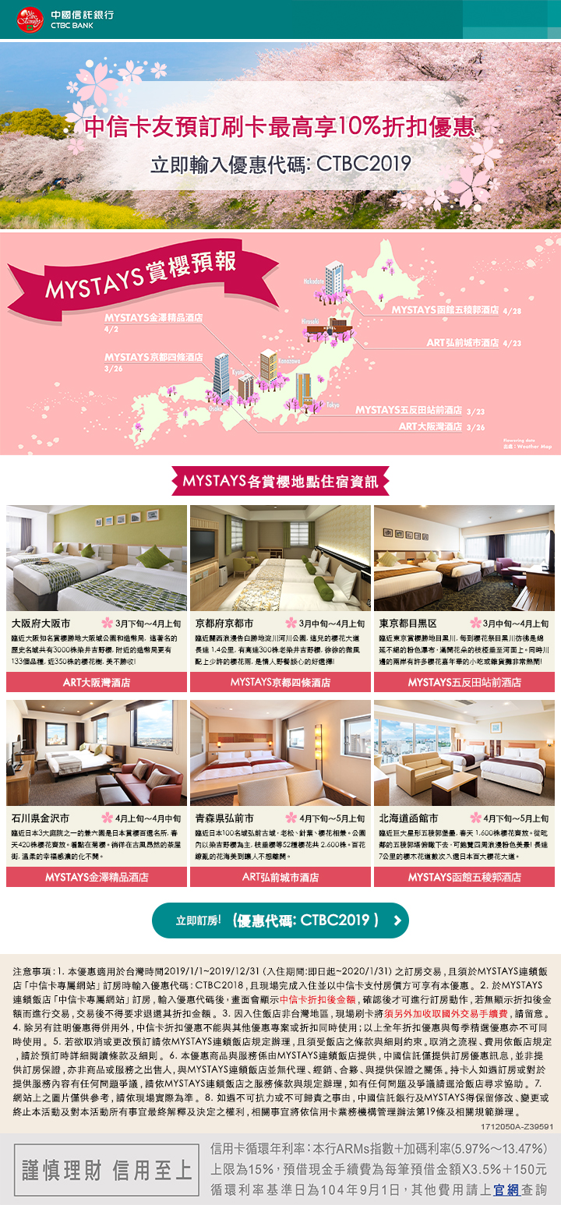
https://www.mystays.com/zh-tw/partners/ctbc/
https://sakura.weathermap.jp/zh-tw.php
(Upper Left 1)
https://www.osaka-baytower.com/zh-tw/?promo=CTBC10
(Bottom Left 1)
https://www.mystays.com/zh-tw/hotel-mystays-premier-kanazawa-ishikawa/?promo=CTBC10
(Upper Left 2
https://www.mystays.com/zh-tw/hotel-mystays-kyoto-shijo-kyoto/?promo=CTBC10
(Bottom Left 2
https://www.mystays.com/zh-tw/hotel-art-hotel-hirosaki-city-aomori/?promo=ctbc10
(Upper Right 1)
https://www.mystays.com/zh-tw/hotel-mystays-gotanda-tokyo/?promo=ctbc10
(Bottom Right 1)
https://www.mystays.com/zh-tw/hotel-mystays-gotanda-tokyo/?promo=ctbc10
https://www.mystays.com/zh-tw/partners/ctbc/

